Slide 1


Air Force Institute of Technology
NENG 791 – Proliferation of Weapons of Mass Destruction
Active Detection of SNM
Lt Col Fee
E d u c a t i n g t h e W o r l d ’s B e s t M i l i t a r y
Notes:
We are now transitioning from methods of passive detection to active detection of SNM.
Can someone, in layman’s terms, tell me the difference between passive and active detection?
Many of these slides were taken from a slide deck developed jointly by the Massachusetts Institute of Technology, The Pennsylvania State University, and Texas A&M University with funding provided by the NNSA through the Global Threat Reduction Initiative. The purpose of this collaboration was to provide academic institutions with increased nuclear security-related education and training for integration in their nuclear science and engineering related programs.

Slide 2
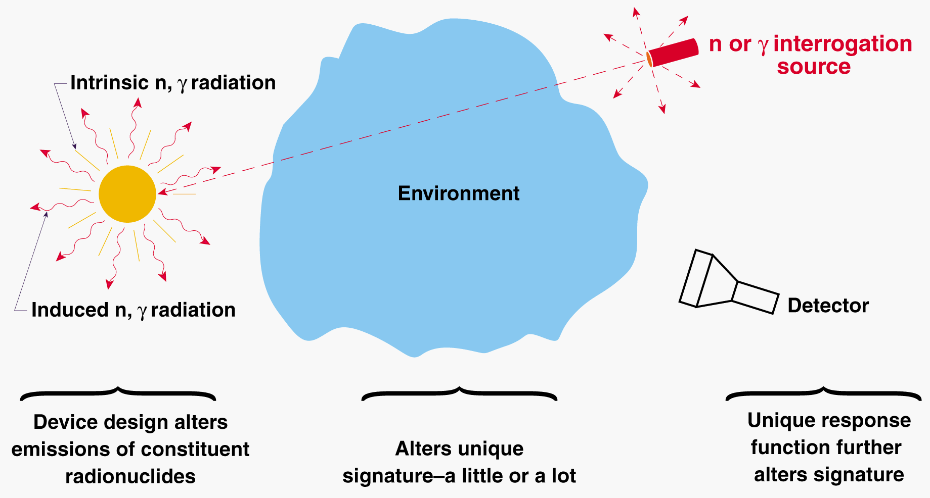
Active radiation detection
Notes:
Can someone tell me about the properties of the material we are trying to find?
It has its own signatures, same as for passive detection.
Can someone tell me about the properties of the interrogation source?
It can either be from an isotropic emitter or from a beam source.
Why do we cite neutrons and gammas as the interrogation source and not protons or other HCPs?
The HCPS don’t penetrate far in matter unless we are at extremely high energies.
The doses from the HCPs eliminate their practical use.
How does the strength of the interrogation source vary for an isotropic emitter? For a beam source?
1/r^2 for an isotropic emitter and virtually none for a beam source.
How does the strength of the signal emitted from the interrogated material vary?
It falls off as 1/r^2.
How can we use timing (our ability to turn the source on or off) impact our ability to look at the emanating response from the interrogated material?
We can look in between pulses or look at signal “die away.”

Slide 3
Characteristics of active systems
Short range and long range systems both possible
Interrogating radiation chosen to interact with SNM inducing characteristic signature
Consider signature induced: how useful are they and what do we care?
Gammas prompt and delayed
Neutrons prompt and delayed
Notes:
What factor limits our ability to use HCPs as a beam source for active interrogation at a distance?
Space charge effects will cause the beam to diverge.
How can we use gamma information to learn about the character of the material we are scanning?
You can have preferential absorption if the gamma energy matches an energy level. When re-emitted the particles would be emitted isotropically.
What is a typical binding energy for a nucleon and how might this impact use of gammas for interrogation?
Typically 6-9 MeV. If you have gammas of this or higher energy, the excited nuclei might emit particles.
If it emits protons, these have a very short range and are not useful.
If it emits neutrons, we may be able to look at these. However, we can’t easily tell where they came from.
Why are we so interested in delayed neutrons and gammas?
They are a highly characteristic signature of fission.
Where do delayed neutrons come from?
Delayed neutrons come from fission product beta decay to a nucleus that then emits a neutron.

Slide 4
Some practical concerns for active inspection
Useful signal is often a very small component of a very large radiation background
Sensitivity and specificity are needed
Would like to have energy, particle type, and timing information
Extremely high instantaneous count rates push DAQ systems and detector electronics…shielding not always the answer
Detectors in proximity to accelerators or pulse-power sources will encounter EMI
Most AI systems must be designed for continuous operation in non-climate controlled, outdoor environment
Automated detection algorithm development is important in producing deployable systems that can be operated by personnel with limited technical expertise
Notes:
What is meant by sensitivity and specificity?
We need to be able to detect it and identify it.
When you are looking at count rates, are you more interested in average or peak count rates?
Peak count rates.
What is EMI?
Electromagnetic interference.
How can the environment impact your active interrogation system?
You might see drift in your detectors so if you are looking for specific peaks you have to worry about the channel windows.
Changes to the atmosphere (humidity, aerosol population, etc) can impact your interrogation beam and impact the retuning signals.
If you were designing a system to be operated by someone who is not a scientist or engineer, what kind of characteristics would you want it to have? (Yes, this is an open-ended question so you can be creative.)

Slide 5
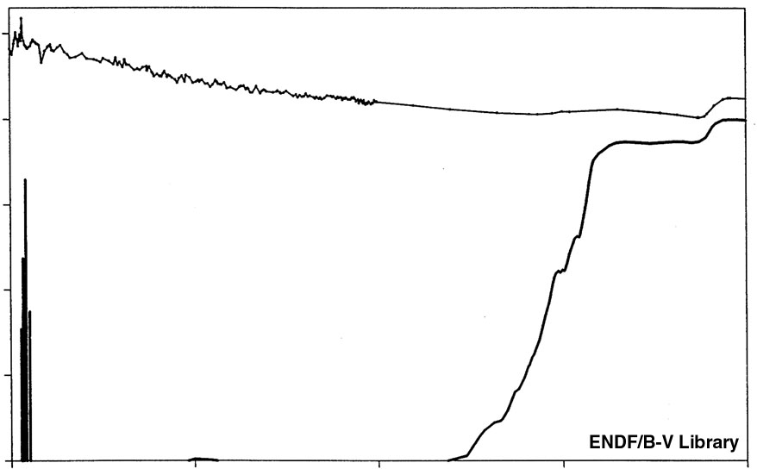
Active detection of HEU – the promise
Active techniques are promising because externally applied radiation can penetrate to deeply imbedded and shielded HEU
Current techniques successfully determine the mass and enrichment of HEU in small, standard, homogeneous samples
These conditions do not hold for nuclear explosives
Examples of active techniques that can be used:
Nuclear Material Identification System (NMIS)
Threshold neutron-induced fission
Neutron-induced differential die-away
Bremsstrahlung-induced photofission
Proton induced fission
10¹
10⁰
²³⁵U
10⁻¹
Fission X-section (barns)
Threshold
10⁻²
10⁻³
²³⁸U
10⁻⁴
0.1
0.001
0.01
1.0
10
Neutron Energy (MeV)
Notes:
We state that current techniques can successfully determine the mass and enrichment of HEU in small, standard, homogeneous samples.
How does this differ from what we see in the real world? What is the impact of the incident material?
What is the fission threshold (you don’t have to be exact) for 235U by a neutron? For 238U?
235 doesn’t have one and you need about an MeV or so for 238.
What is photofission? Is it purely from Bremsstrahlung or can get it from higher energy gammas?
Why is proton induced fission probably not practical for an active interrogation system in the field?
Protons, like all HCPs, just don’t go very far in matter.

Slide 6
Active detection of HEU – some drawbacks
Booby traps—the radiation switch
Exposure of live warheads to incident radiation
Divergent interrogation sources
Inspection personnel and detector exposure problems
Stowaways
Impractical for long-distance detection
Not all interrogation sources are divergent
Possible need for dedicated facility
Useful interrogation sources are often complicated and expensive
Dose may be high for long distance beams
Notes:
Can someone explain to me why a “booby trap” might be a problem?
How might device design impact the dangerousness of exposing a weapon to incident radiation?
What if the weapon is designed such that in its current configuration it is very, very close to critical?!
Why might we need a dedicated facility?
Control of environmental factors.
Maintenance of the equipment.
These problems help explain why passive detection methods have been much more widely deployed than active systems. What are other reasons why this is the case?
Cost.
Politics.

Slide 7
The need for active detection
Passive detection is:
Easy to negate with shielding
Can be masked with other isotopes
Low signal-to-noise at long-range
Notes:
You already understand the need for active detection. (That was the whole purpose of the previous block of instruction.)
This slide shows the impetus for active interrogation.
Background doesn’t fall off as 1/r² but your signal does.
Lower energy photons are easily attenuated and, from a “point” source fall off as 1/r².

Slide 8
Active interrogation methods
A few active interrogation methods:
Transmission density measurement
Photofission
Nuclear resonance fluorescence
Neutron-induced fission
Associated particle imaging
Gamma-ray backscattering
X-ray radiography
Can you name some advantages of active interrogation methods?
Notes:
For each of these, you can explain in your own words:
What is a transmission density measurement and how is it done?
How would we use photofission for Active Interrogation?
What is NRF and how might we use it for Active Interrogation?
If you are using neutron-induced fission, what would you look for?
What is associated particle imaging?
What is gamma-ray backscattering?
What is x-ray radiography and how is it used?
Can you name some advantages of active interrogation methods:
energy and intensity can be adjusted to provide appropriate response
adjustable timing
can be applied to low- and high-density materials
can be applied to shielded materials
can be applied to all fissile and fissionable materials

Slide 9
Available signatures for neutrons and photons
Measured Particle
Reaction
Reaction
Neutrons
Inelastic Scattering, (n,2n) Absorption, Fission
Prompt Gamma
Scattering, Resonance Fluorescence, Photofission
High-Energy X-Rays
(n,2n) Multiplication, Fission
Prompt Neutron
(g,n), Photofission
Decay Following Absorption or Fission
Delayed Gamma
Decay Following Absorption or Fission
Decay Following Absorption or Fission
Delayed Neutron
Decay Following Absorption or Fission
Transmission/ Attenuation
Radiography
Transmission/ Attenuation
Transmission/ Attenuation
Tomography
Transmission/ Attenuation
Neutron Slowing Down via S
Neutron Die-Away
Photoneutron Slowing Down via S
Scattering
Associated Particle
Notes:
We’ve seen this slide before but now we have a chance to talk through it.

Slide 10
Timescale of the fission process
Notes:
By now, you have a good deal understanding of the fission process. This is for your review!!!!

Slide 11
Prompt vs delayed radiation detection
Do most active interrogation methods rely on measurement of the prompt or delayed radiation? Why?
How do the count rates for prompt and delayed radiation compare? Why?
Are prompt or delayed radiation detection techniques more sensitive?
How can you distinguish between neutrons and gamma rays?
How does collimation, shielding, and the (general) environment impact the interrogation radiation and the signal?
Notes:
(1) Most active interrogation techniques rely on the measurement of the delayed radiation. This is because it can often be harder to pick out the desired signal while you have your active source also providing counts.
(2) Prompt radiation provides many more counts per fission per unit time than delayed radiation. Prompt signal is orders or magnitude larger than the delayed response.
(3) Prompt radiation detection techniques have a much higher sensitivity. They are easier to detect because they are present in much larger quantities.
(4) You can use pulse-shape discrimination. Rise time is the same but energy in the tails differs.
(5) in-scatter. Attenuation. Creation of other signals..

Slide 12
Delayed gamma detection (1)
Where do the delayed gammas come from?
What characteristics of the gammas make some of them easy to distinguish from the natural background radiation?
What are some of the advantages of using delayed gamma over delayed neutron signatures?
Are the gamma ray intensity distributions the same for each fissionable isotope or do they vary?
Notes:
Where do the delayed gammas come from?
emitted from excited fission products
emitted during the beta decay of many short-lived fission products
What characteristics of the gammas make some of them easy to distinguish from the natural background radiation?
some have very high energies, and are thus easy to distinguish from the natural background where high-energy gamma-rays are rare.
What are some of the advantages of using delayed gamma over delayed neutron signatures?
intensity of the high-energy delayed gamma-rays (E > 3 MeV) is about 10 times larger than that of delayed neutrons
the high-energy gamma-rays are highly penetrating. They typically undergo 10-100 times less attenuation in thick cargo than delayed neutrons.
intense high-energy delayed gamma-rays are a unique signature for SNM. They are not easily observed after the irradiation of benign materials or in the natural background, nor are they produced in significant amounts by neutron activation of the cargo and surrounding materials.

Slide 13
Delayed gamma detection (2)
unique gamma-ray intensity distributions exist for each fissionable isotope; thus these can be used to distinguish between the nuclear materials
delayed gamma-ray energy spectra are rich and complex, but it is possible to resolve individual lines with high resolution detectors
relative amplitudes of certain lines (i.e. ⁹⁷Y and ⁸⁹Rb) vary significantly from nuclear isotope to isotope
discrimination ratios of order 3 were observed between ²³⁵U, ²³⁹Pu and ²³⁸U
Intensity ratios of the fission product gamma-rays induced by 10 MeV bremsstrahlung photons and measured 13-100 ms after the irradiation
Notes:
This is all well and good but our primary concern is first detecting that we have SNM.
Determining the kind of nuclear material is a different problem set.
Our portal monitors (at least the primary screen) don’t have to positively ID the isotope. That is a more complex problem.
We previously talked about how incident material can attenuate the photon emissions.
It seems quite interesting that the gammas listed here are all about an MeV or so.
What photon interaction process will dominate for all of these gammas, regardless of the material?
Compton scatter.
How do the Compton mass attenuation coefficients vary depending on the different types of materials that might be incident?
They are all about the same because of the electron density is about the same (except for hydrogen). Can you explain why?
So maybe a smart algorithm can identify or differentiate between some of these materials… your thoughts????

Slide 14
Prompt radiation detection techniques
Prompt gamma-rays and neutrons are emitted within 10⁻¹⁵ seconds after the interaction
Can prompt radiation be emitted between pulses?
How do the prompt neutron and gamma-ray yields from photofission and neutron-induced fissions compare? Why?
So why aren’t we using prompt neutron detection?
Notes:
Can prompt radiation be emitted between pulses?
Yes. Prompt radiation can also be emitted between irradiation pulses when the fission is induced by delayed neutrons
How do the prompt neutron and gamma-ray yields from photofission and neutron induced fissions compare?
Prompt neutron and gamma-ray yields from photofission reactions are of similar magnitude to the ones induced by neutrons
So why aren’t we using prompt neutron detection?
Utilization of prompt neutron detection could greatly reduce the scan time, but is difficult as the magnitude of induced radiation is much smaller than that of incident radiation
It requires very fast DAQ to handle the high event rates

Slide 15
Transmission density measurement
So what is a transmission density measurement and how do we do it?
Notes:
Reduction of the gamma flux (I/Io) for a given energy gives you an idea of how much mass you have passed through.
We usually use as a supplement for accurate gamma-ray assay. What does this mean?
(1) What energies would we use?
the sample is irradiated by an external source of photons of energies similar to the energies of interest
(2) What does this have to do with accurate gamma-ray assay?
measured attenuation of the photons by the object is used to correct the gamma-ray assay results for the expected loss of emitted photons
(3) This can extend the applicability of passive gamma-ray assay to dense materials, through which only a fraction of the spontaneously emitted gamma-rays can reach the detector
But what is the problem with dense materials?
(4) Should you “spin” the objects during the scan?
for objects close to the detector, they are usually spun during the scan to improve the uniformity of the sample response
otherwise it is placed at a sufficient distance from the detector so that the source position variations can be ignored.

Slide 16
Dual-energy transmission measurement
Can someone explain the concept of a dual-energy transmission measurement?
How can the energy you choose to use impact the need to consider background?
What happens to the very energetic photon depositing its energy in a detector?
If you have a higher energy photon (no natural gammas near that energy) how might these photon interactions impact your ability to determine the attenuation of the lower energy photon?
What happens to the photon flux as the mass of the cargo increases?
Notes:
Can someone explain the concept of a dual-energy transmission measurement?
Basically, the mass attenuation coefficients vary as a function of Z and photon energy.
Different energy photons attenuate differently in different materials.
How can the energy you choose to use impact the need to consider background?
If the photon is well above background energies then the counts can only come cosmic rays (likely higher energy events) so you can sum counts over a region.
What happens to the very energetic photon depositing its energy in a detector?
You get a long tail from bremsstrahlung.
You don’t get good efficiency from a semiconductor.
If you have a higher energy photon (no natural gammas near that energy) how might these photon interactions impact your ability to determine the attenuation of the lower energy photon?
Continuum underneath the lower-energy peak.
What happens to the photon flux as the mass of the cargo increases?
It decreases exponentially so you need more fluence (which equates to longer beam time and/or higher flux) to get the needed counts.

Slide 17
Dual-energy transmission radiography
Nuctech Company Ltd.
use dual-energy LINAC to produce two X-ray beams with different energy distributions
use differential attenuation to identify materials
Notes:
This is an image from two x-ray beams.
What is the problem with using x-rays?
Dose!
What are some of the advantage of using x-rays?
It’s pretty easy!
That’s a pretty nice looking image that is easy to read!
Don’t get pixelization (like we do with “big” detectors)
How might you smuggle SNM through something like this?
Use a lot of mass.
Distribute it in very, very small pieces.

Slide 18
X-ray scattering
frequently used in mine detection
low penetration
Notes:
So how does this work?
X-ray backscatter signal proportional to Z of the material!
Why might this be useful for mine detection?
Would the plastics or the metal components lead to a larger signature?

Slide 19
Photofission
Notes:
We’ve talked about photofission on several occasions.
Here you see that there is a broad cross section from about 10-20 MeV incident photon energy.
Why would be look at the delayed neutrons to determine whether there is fissile / fissionable material?

Slide 20
Photofission thresholds
Notes:
Here are the photofission thresholds for various nuclides.
Note the photoneutron thresholds for Nitrogen and Oxygen. If you use gammas of these energies (or higher) you must consider the impact of the (gamma,n) on the signals you will receive.

Slide 21
Day 2

Slide 22
NRF detection: the scattering method (1)
What is different about the energies of the NRF photons that will allow them to be detected? Think about the physics of what is happening.
Notes:
We know that the photon energy for a backscatter will be much lower than the incident energy.
What is different about the energies of the NRF photons that will allow them to be detected?
These photons are absorbed and then emitted isotropically. Since they are absorbed and then reemitted, the shift to energy will be slight (from absorption recoil and emission recoil). If you look at the right energy and angle, you should be able to find an NRF peak.

Slide 23
NRF detection: the scattering method (2)
the incident irradiation is tightly collimated so that nothing else but the sample is irradiated by the beam
a detector with adequate energy resolution is placed at a backscattering angle, also narrowly collimated so that it only sees the sample
collimation and shielding are extremely important in this kind of experiment, because scattering from surrounding objects could significantly degrade the signal to noise ratio, where the enormous counting rate of off-resonant photons can saturate the detector even at a very low resonant photon flux
For thin target:
For thick target: a more complex situation - ideally have some knowledge of the composition of the target
Notes:
Here it is cited that we need “adequate” energy resolution. What is adequate?
Well, it depends on the energies you are looking at…
What makes a target a “thick” or “thin” target?
Self-absorption.
How will thick target impact the signal?
Reduce counts and lead to additional scatters.

Slide 24
NRF detection: the transmission method (1)
require a “notch detector” to measure preferential attenuation of photons corresponding to NRF

Slide 25
NRF detection: the transmission method (2)
Consider a thin absorber and scatterer:
with absorber
without absorber
n_{s}, n_{a} - particle densities in scatterer and absorber
d_{s}, d_{a} - thicknesses in beam direction
Fractional change in count rate (R) - independent of resonant flux intensity and proportional to number of nuclei in the absorber

Slide 26
NRF detection using a notch detector

Slide 27
Immunity to false negatives

Slide 28
Inverse density radiography
Notes:
Can you explain the physics of what is going on in each picture? Think of the possible interactions between the photons and the material.
If you use an energy dominated by Compton effect, you will see that (to the left) you have a lower areal density so you get less absorption where the Li is embedded in the Pb
If you use a photon energy that “matches” an absorption level in material, it will be preferentially absorbed and emitted over 4 pi, resulting in a decrease in your counts at the detector.

Slide 29
Passport Systems NRF scanner (1)
W. Bertozzi, et al. Nucl. Instrum. Methods B 261, 331 (2007)
identify region of interest (ROI) in 3D where Z is high
identify and quantify isotopes in that region (such as ²³⁵U) - use multiple spectral lines in the NRF spectrum to improve SNR
- typical photon flux in 10 eV: 10⁸/s on 20x20 m² target a 2 m distance

Slide 30
Passport Systems NRF scanner (2)
collimated bremsstrahlung beam and collimated detector define voxels
detectors placed beyond 90º: no EM process produces photons >0.5 MeV, minimizing background
NRF spectrum of 1.7 kg ²³⁸U surrounded by 1/4” Pb

Slide 31
Effective Z (EZ-3D) determination
use continuous non-resonant portion of the spectrum above 400 keV to determine effective Z
this portion of the spectrum is due to multiple processes in the scattering material interacting in a complex and Z-dependent manner
Notes:
Here you are able to use transmission information to gain knowledge about the location of embedded material.
What will you see if there is a density- or Z-eff mismatch?
If you have mismatches (high-Z in low-Z or high-density in low-density or vice versa) you will be able to see an artifact in the figure.

Slide 32
Narrow bandwidth source for NRF detection (1)
J. Pruet, et al., J. Appl. Phys. 99, 1213102 (2006)
Upscattered laser pulse energy
calculated on axis brightness
- low radiological dose
- short scan time
- low error rate

Slide 33
Narrow bandwidth source for NRF detection (2)
simulation for “notch” development in transmitted beam for a cargo container filled with water and 2 cm disk or U
Challenge: notch-filling problem by small-angle scattering

Slide 34
Bremsstrahlung photon source demonstration
Thin high-Z target
Threshold Goal: Stand-off detection of ²³⁵U at ~100m
Filter
e⁻
g’s
Electron beam generator, ~20 MeV
Collimator
100 cm
e-beam dump
Germanium detector
g
20 MV thin-target, filtered, brems
U or Pb
Pb
Fe
CH₂
H₂O
LINAC produced photons cause special nuclear material target to fission
Identify target material by prompt and delayed gammas and neutrons
Must produce sufficient induced signal while minimizing radiation dose to crew on interrogated vessel
First generation system: 3 tons, 5 m³
Notes:
How high of a photon energy (peak for the bremsstrahlung spectrum) do we need to cause fission?
Previously we said at the fission threshold (about 5-6 MeV) but around 10-15 MeV if we want the broad resonance which has a cross section of mb.
How do we determine the SNM isotopes by the prompt and delayed signatures? Coincidences, die away, etc.
What kinds of issues will we encounter? Efficiency… et al

Slide 35
Monoenergetic photon imaging: approach
The fundamental approach is to generate both neutrons and mono-energetic gamma rays by means of low energy nuclear reactions.
This multi-particle method images the SNM through shielding and also identifies it by inducing fission in the suspect material.
Use transmission imaging to locate high-Z materials
Use photofission and/or neutron induced fission as final check
Why use monoenergetic imaging?
an order of magnitude or more reduction in dose
enhanced sensitivity in detection and verification
lower requirements for shielding
the ability to reduce the size of the source part of the system by an order of magnitude or more while still meeting requirements for detection and identification of SNM
flexibility in detection through radiography and active probing with the same device

Slide 36
Some candidate reactions
Reaction | Energy MeV | Gamma Energies | Gammas/particle
¹¹B(d,n) | 4 | 4.4, 10.7,12.7,15.1 | 1.2 x 10⁻⁵
⁷Li(d,γ) | 0.36 | 12,14,15,17 | 1.6 x 10⁻⁷
¹¹B(p,γ) | 0.17 | 12.2,17.2 | 8 x 10⁻¹¹
⁷Li(p,γ) | 0.4 | 14.6, 17.6 | 1.1 x 10⁻⁸
¹⁹F(p,γ) | 0.34 4 | 6.13, 6.92, 7.13 | 1.7 x 10⁻⁸ 1.0 x 10⁻⁵
Photoneutron emission threshold:
<6 MeV in nuclear materials
>7.5 MeV in common materials
results in low (gamma,n) background: prompt neutrons can be counted
smaller photofission cross section at 6-7 MeV is compensated by the greater intensity of prompt neutrons and a low (gamma,n) background

Slide 37
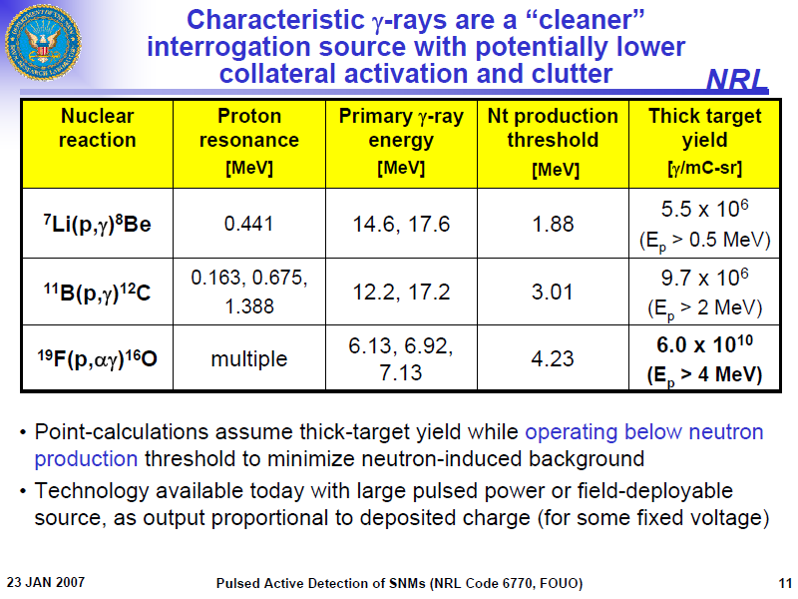
Characteristic gamma-ray interrogation source
Characteristic γ-rays are a “cleaner” interrogation source with potentially lower collateral activation and clutter
Calculations assume thick-target yield but operate below neutron production threshold to minimize neutron induced background

Slide 38
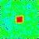
15.1 MeV transmission image
100 cc U cube in 40 cm Fe block imaged with 15.1 MeV gammas (MCNPX simulation)

Slide 39
Identifying SNM
Transmission measurement alone only identifies high-Z material
Use two approaches to distinguish ²³⁵U by detection of fission products
Utilize photofission
Probe with low energy neutrons (< 1MeV)
Use the 9.0 MeV p in a (p,n) reaction
e.g. ⁵⁰Cr(p,n)⁵⁰Mn Q = -8.42 MeV which results in E_{n} < 1 MeV, below fission threshold for ²³⁸U

Slide 40
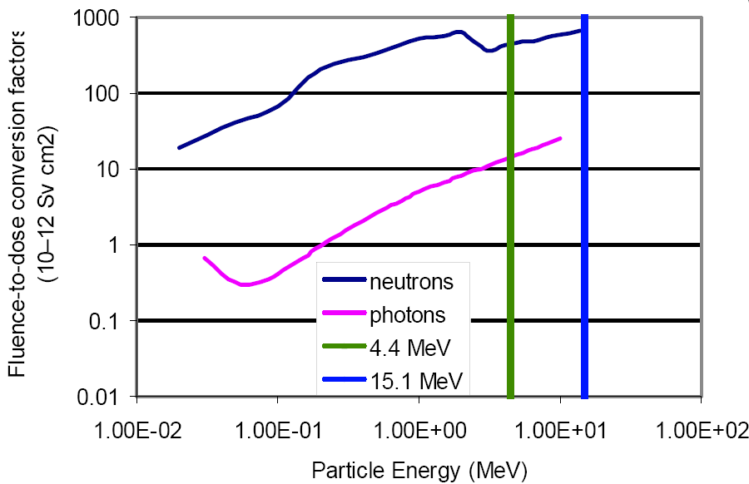
Fluence to dose for detection

Slide 41
Past experience with photonuclear inspection
Early inspection utilized 6-10 MeV photons
Simple counting of delayed neutron and gamma emissions between pulses or post-irradiation
Recent improvements to photonuclear inspection included assessing prompt emissions of neutrons
Higher energies of 10-20 MeV investigated
Neutron Counting Rate (n/s)
Time (ms)

Slide 42
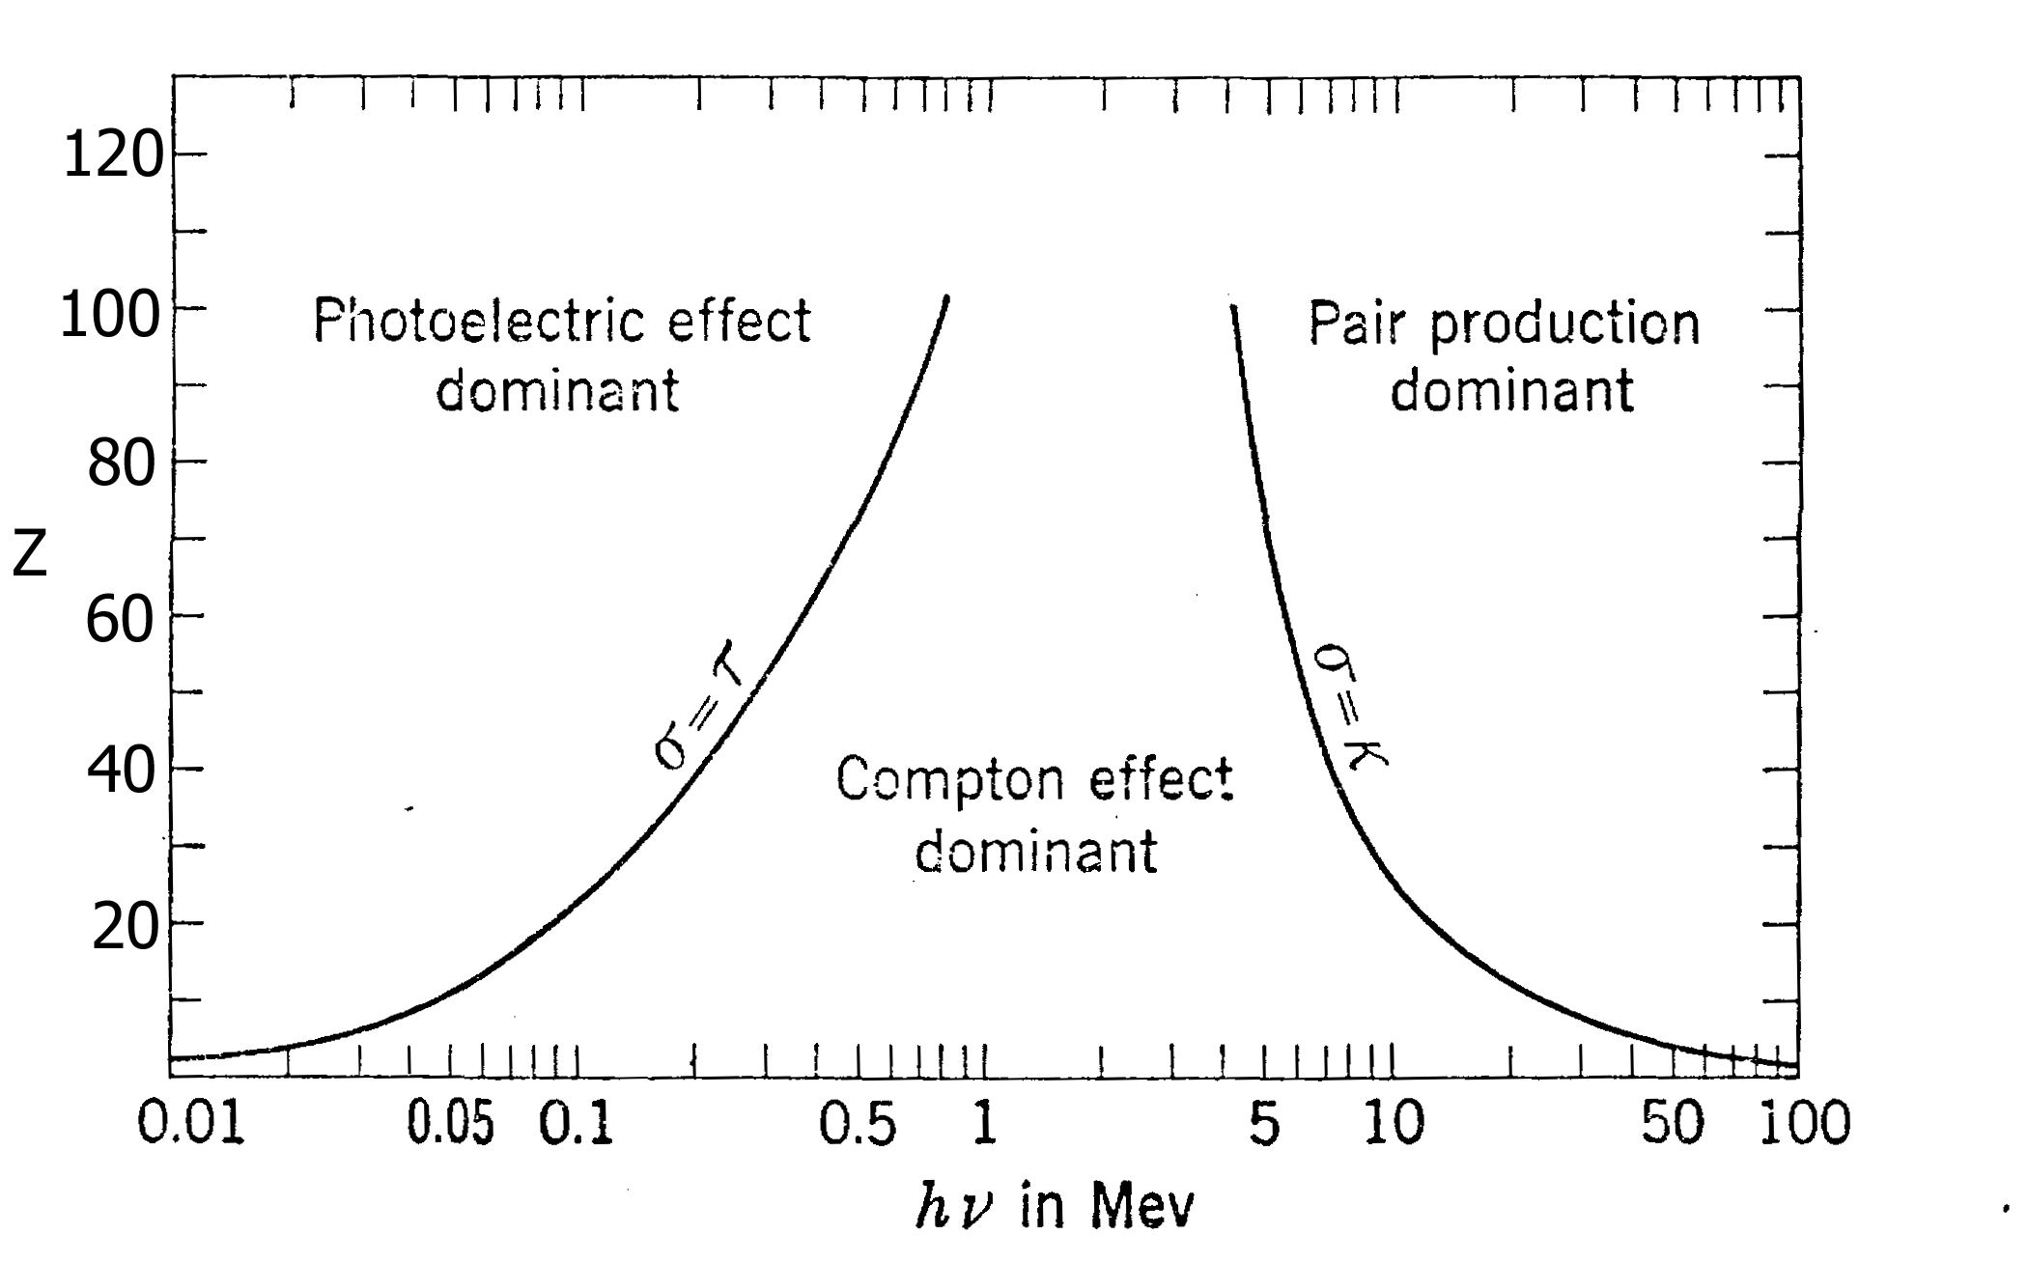
A “non-nuclear” active interrogation method: using high-energy photons for Z discrimination

Slide 43
Using high-energy photons for Z discrimination: approach
Set as goal detection of materials with Z>72
Gets fissile material but also W and Pb
Measure high energy photon transmission at two energies e.g. 5 MeV and 10 MeV
Based on differences in pair production, we can distinguish high Z materials in an image
Problem is that only the photons at the top end of the continuous spectrum exhibit a difference so the effect is small

